Slide 1
Abdominal Protocol
Dr. Tze Chia
True North Imaging
Annual CME Day
May 6, 2018

Slide 2
Check Previous Exams
Always check for previous relevant studies, including US, CT, MR, and Mammography
**Write down date of comparison study
**If following lesions, please look at previous images to ensure following the same lesions
Follow each lesion carefully. Indicate any NEW lesions.

Slide 3
Checking Outside Studies: https://portal.tnicorp.com

Slide 5
Fill in Patient ID
OR
Fill in Accession Number
Select a series
Click on “List all studies for patient”

Slide 7
Clinical History
Read requisition. Our purpose is to answer the clinical question.
**Write down clinical history
**For palpable masses, provide complete clinical history:
Location of the mass (Diagrams are helpful)
How long the mass has been present
Any change in size of the mass
Presence of pain
Associated symptoms: fever, redness, swelling, bruising

Slide 8
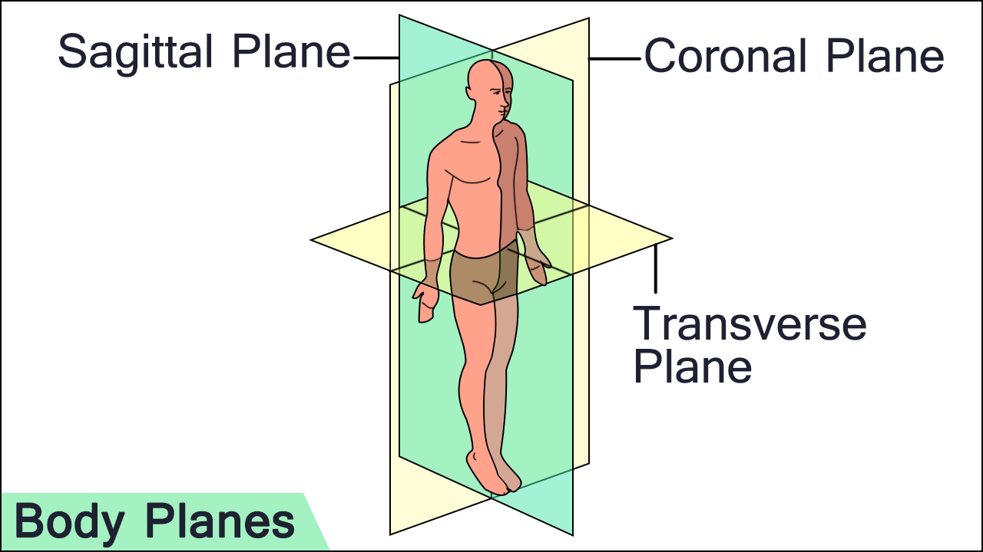
Anatomical Planes
or Axial

Slide 9
3D Measurements
Sagittal x Transverse x AP
Transverse
Sagittal
AP

Slide 10
3D Measurements
**Every lesion requires 3 images
Image without measurements; shows lesion characteristics
Image with measurements
Image with colour doppler +/- pulse doppler
**All lesions measured in 3 dimensions: Sagittal x Transverse x AP
Always use centimetres and to 1 decimal place
Example: 2.04 cm rounds to 2.0 cm, NOT 2 cm
**Record current measurements and then previous measurements in brackets
If there are multiple lesions, measure representative marker lesions to ensure the same lesions will be followed

Slide 11
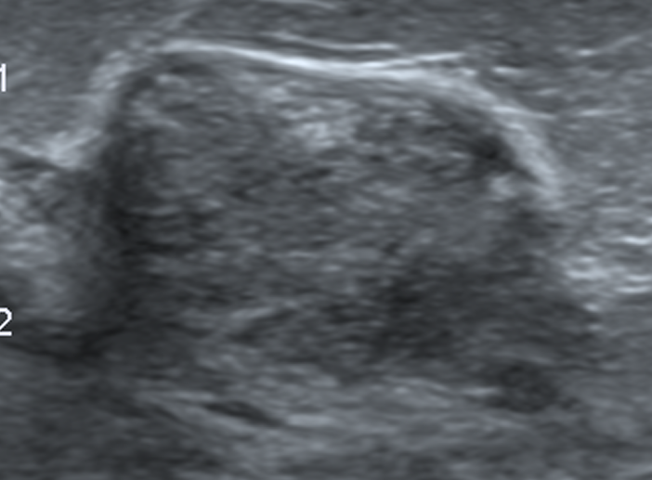
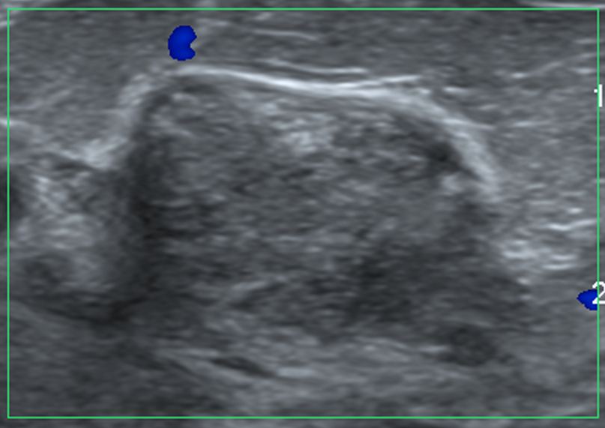
3 Images

Slide 12
Pediatric Patients
For all pediatric patients, give normal range in brackets for all measurements
Use chart provided in ultrasound tech binder and use suggested limits of normal column

Slide 13
Findings
Clearly write down all relevant findings.
**Please do not leave any part of the worksheet empty
Please use the terms “negative study” or “unremarkable”
Only use “normal” if all anatomy seen clearly
If cannot find previous pathology, state on the tech sheet so we know this area was specifically scanned

Slide 14
Cysts
Should be categorized as SIMPLE or COMPLEX
COMPLEX cysts:
Septations. Check thickness and vascularity
Solid components
Mural nodules
Calcifications

Slide 15
Palpable Lesions
Always label “AOC” on worksheet and images
“AOC” should be on images even if no abnormality is visualized
Also document on worksheet if concern is not palpable by the patient

Slide 16
Focal Zones
Please ensure focal zones are at the right depth
Depending on patient factors, may need to scan with more than 1 transducer to get proper depth and frequencies

Slide 17
Liver - Views
Transverse views:
Rt lobe/lung
Rt lobe/hepatic veins
Rt lobe/portal veins (main, right)
Rt lobe/GB/kidney
Lt lobe/hepatic veins
Lt lobe/left portal vein, include image of portal vein at confluence
Lt lobe/caudate lobe
Sagittal views:
Lt lobe/aorta
Left lobe/caudate lobe/IVC
Rt lobe/dome (diaphragm)
Rt lobe/lung
Rt lobe/portal vein
Rt lobe/kidney

Slide 18
Liver - Views
Important things to note:
Pleural effusion
Pericardial effusion
Ascites
etc

Slide 19
Liver - Measuring
Technique needs to be consistent to compare size over time
Right midclavicular line
Maximum oblique measurement

Slide 20
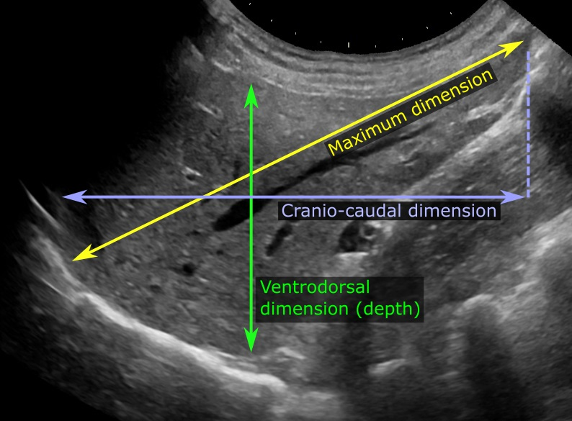
YES
NO!
NO!

Slide 21
Liver – Focal Fatty Sparing
Appearance:
Geographic
No mass effect
No distortion of vessels
Characteristic locations:
Adjacent to porta hepatis
Adjacent to gallbladder fossa
Adjacent to falciform ligament
Subcapsular parenchyma

Slide 22
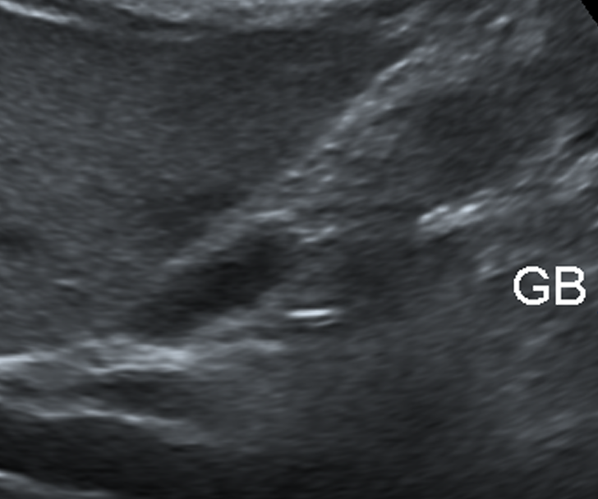
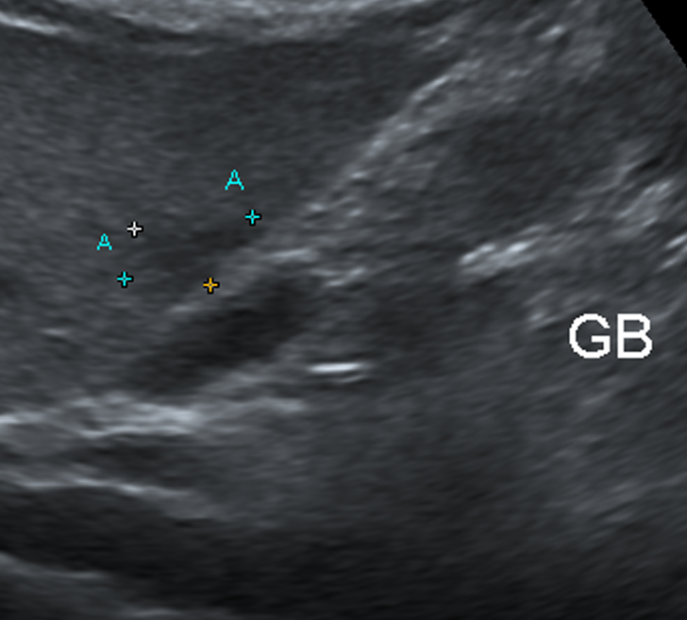
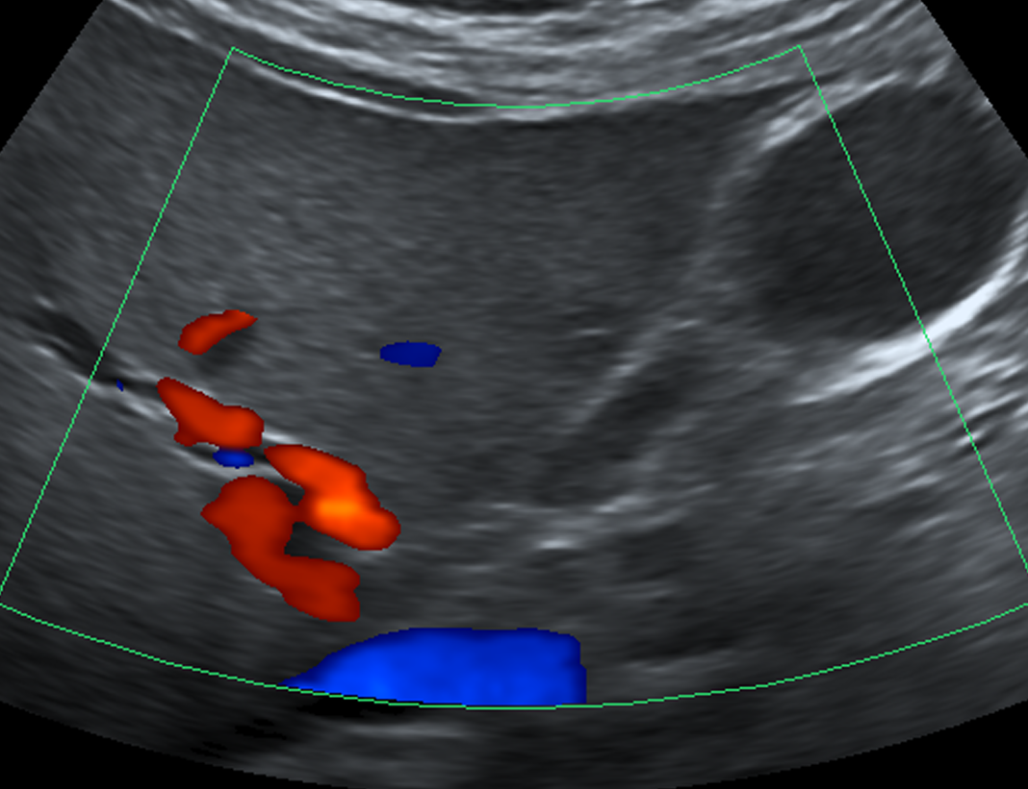

Slide 23
Liver – 8 Segments
Need to start using liver segments to describe liver lesions
Segments I – VIII
More accurate than simply Right Lobe or Left Lobe
Makes it easier to follow liver lesions

Slide 24
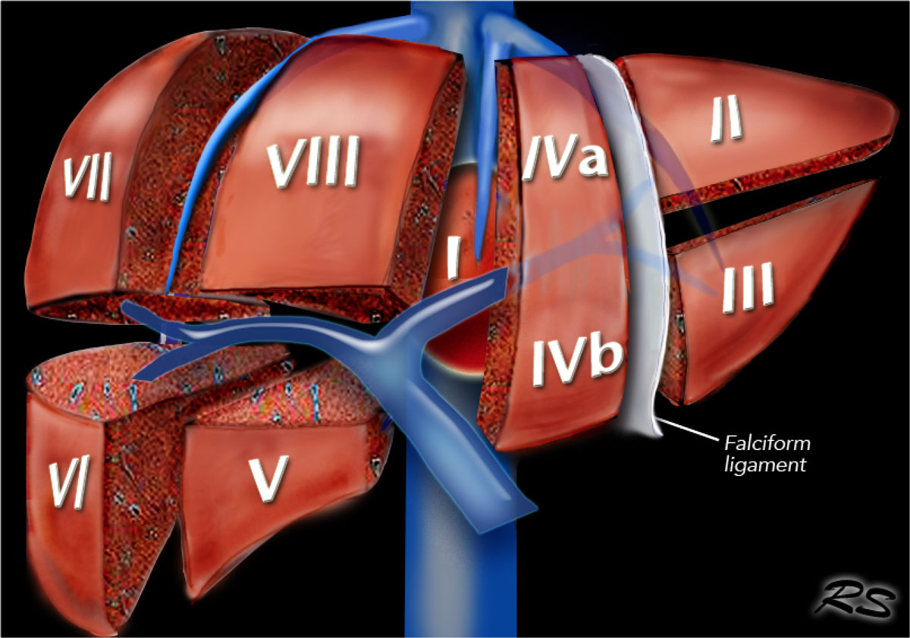
Important landmarks:
Right hepatic vein
Middle hepatic vein
Falciform ligament
Portal vein

Slide 25
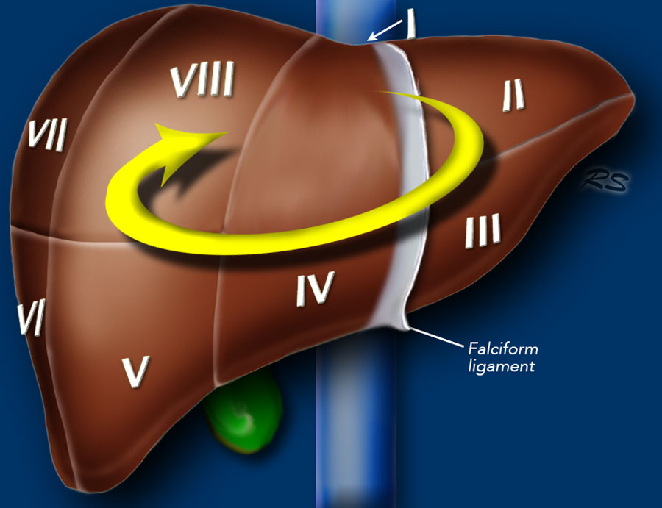
Numbering is clockwise

Slide 26
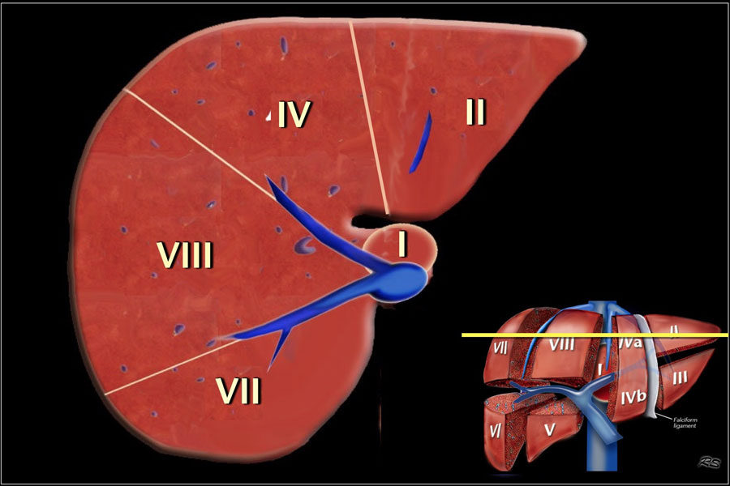

Slide 27
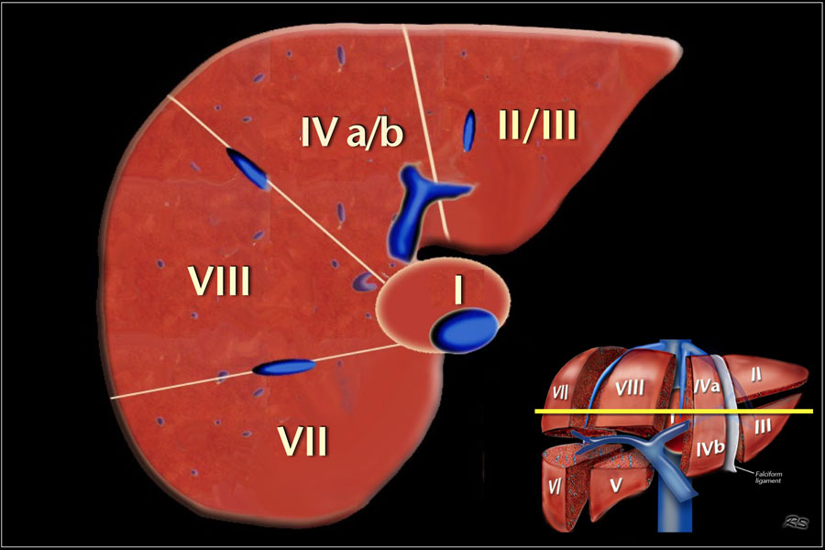

Slide 28
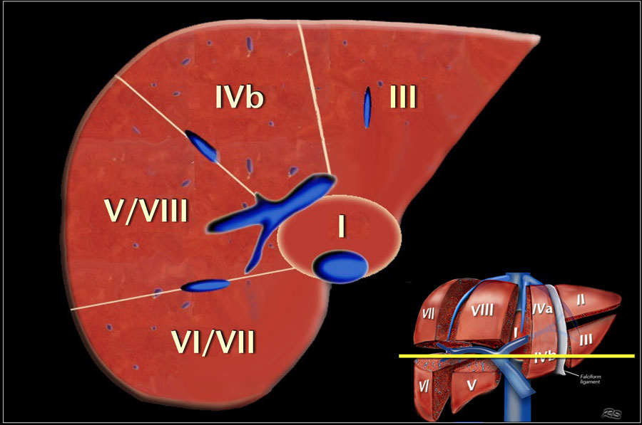

Slide 29
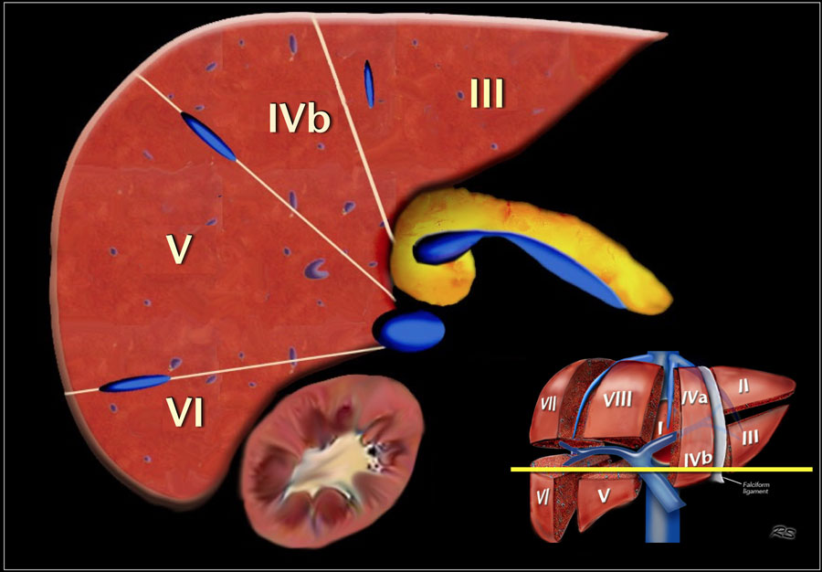

Slide 30
What segments in left lobe?
II, III, IVa, IVb

Slide 31
What divides the Left and Right liver lobes?
Middle hepatic vein
Gallbladder fossa

Slide 32
What divides the upper and lower segments?
Portal vein

Slide 33
Gallbladder
Long axis and transverse views in both the supine, left lateral and/or upright positions
**Need to visualize gallbladder neck
Document transaxial measurement if distended (>4cm is abnormal).
Measure gallbladder wall thickness. Make sure perpendicular

Slide 34
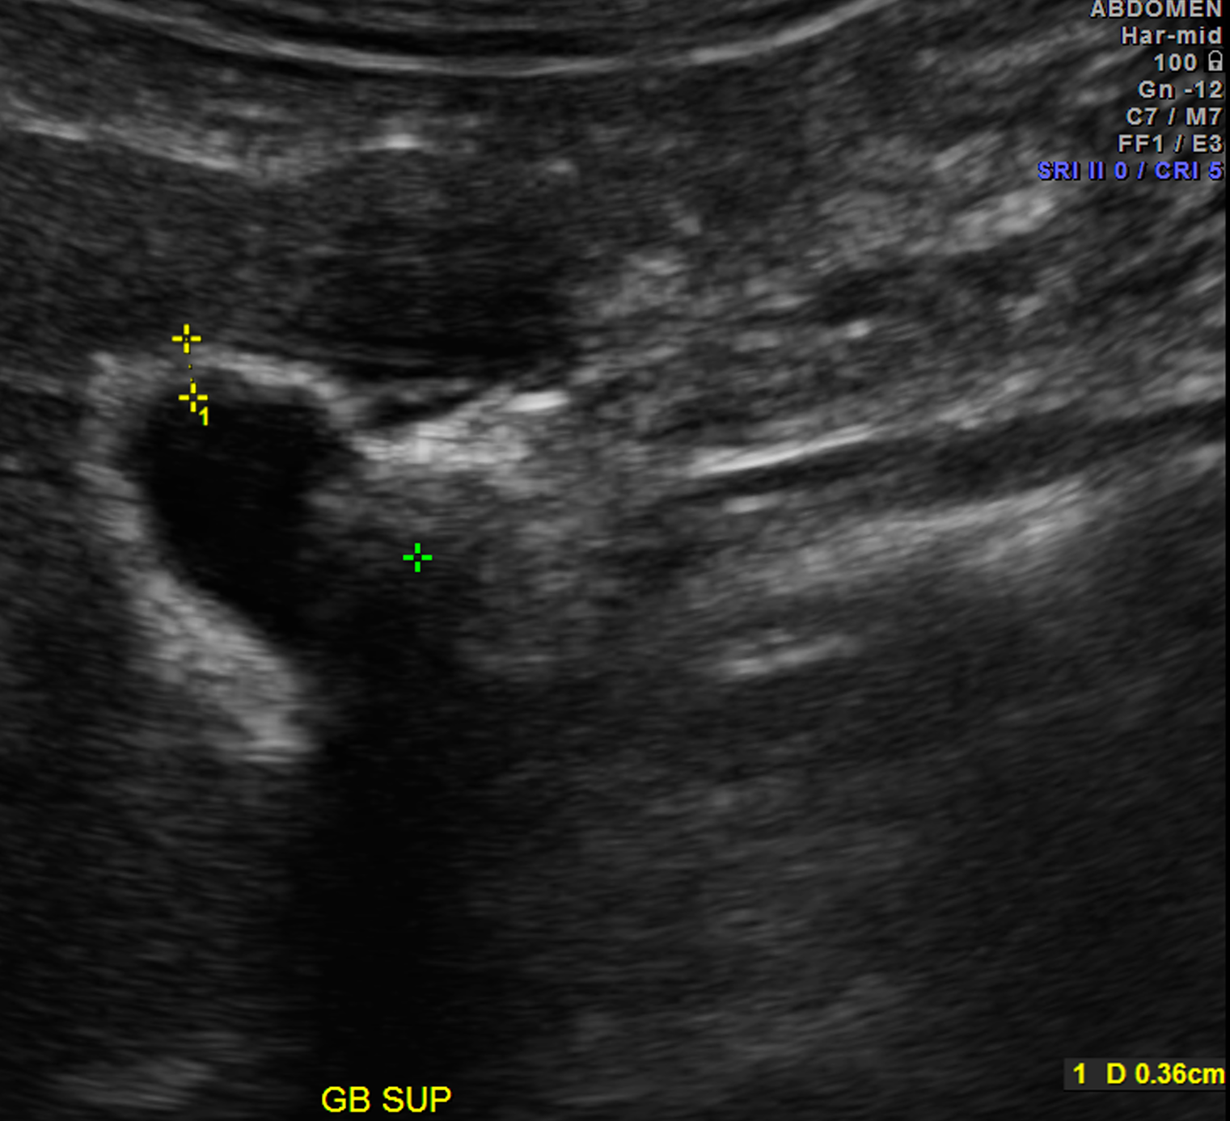
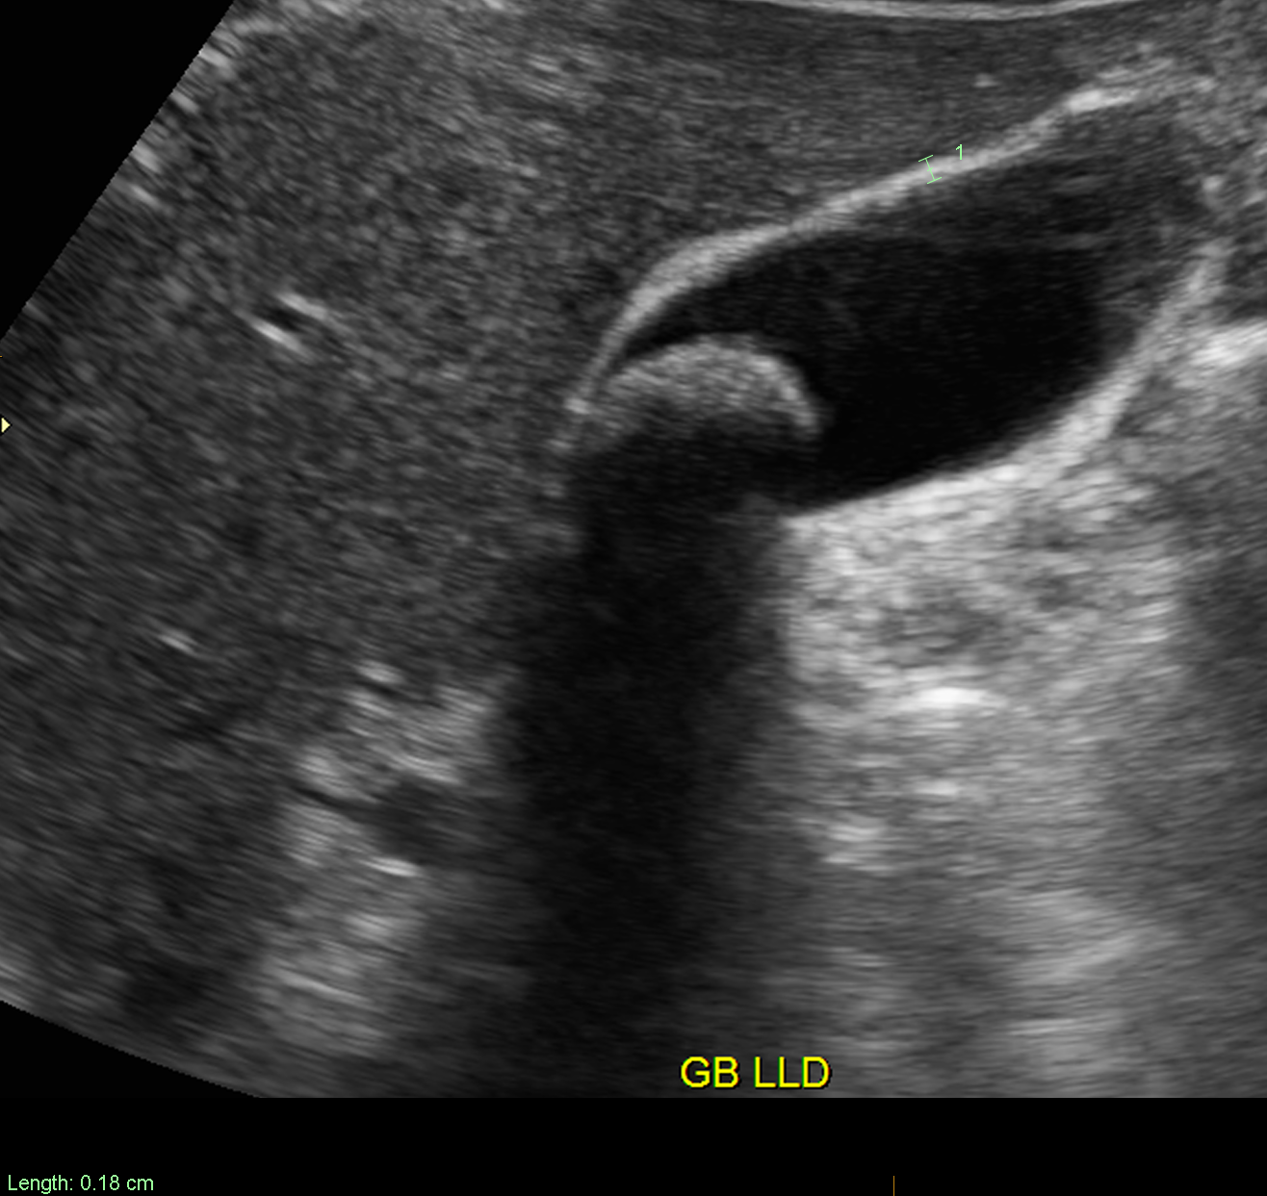

Slide 35
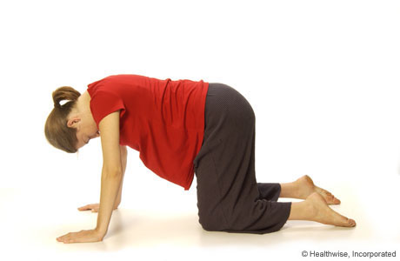
Gallbladder
Always measure the largest stone or polyp
**Need to document if stones/sludge mobile
Lateral decubitus
Upright
**Supine on all fours
**If stones, document Sonographic Murphy’s sign
MAXIMAL abdominal tenderness from pressure of US probe over GB
Do not prompt for tenderness. Look for visual/audio signs.
If patient reports tenderness, compare with LUQ

Slide 36
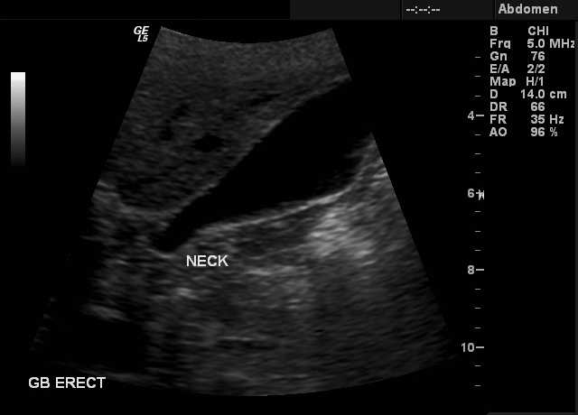

Slide 37
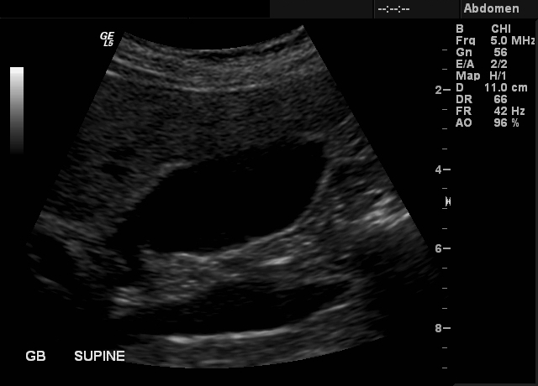

Slide 38
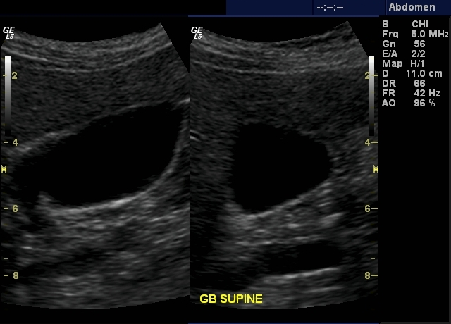

Slide 39
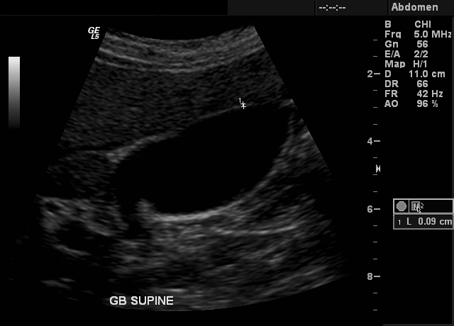

Slide 40
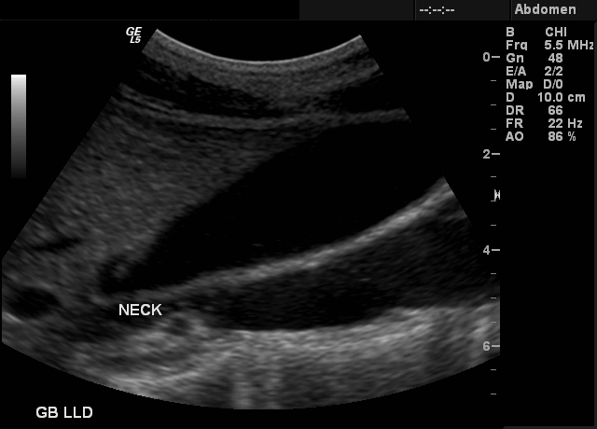

Slide 41
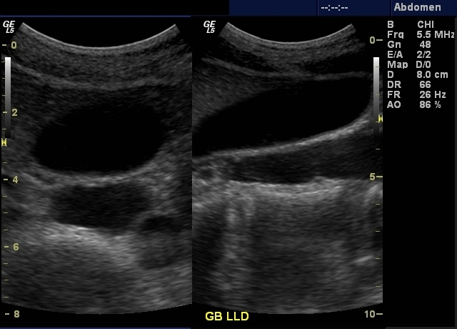

Slide 42
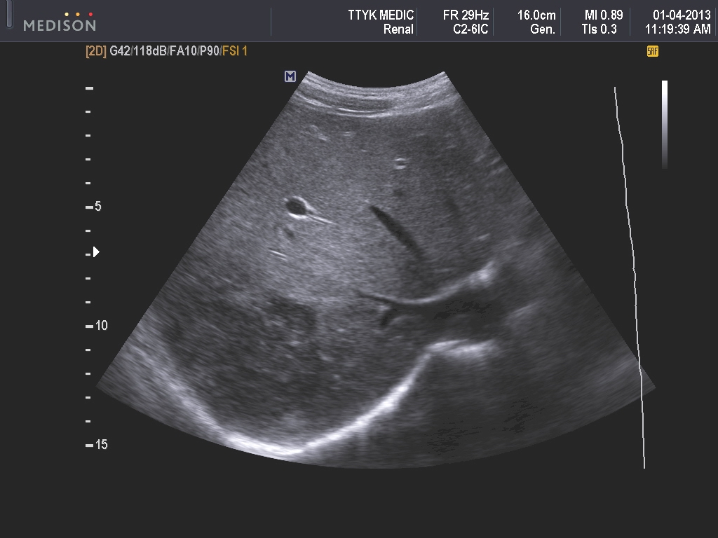
Segment?
High; Origin of MHV
Posterior subcapsular
Segment VII

Slide 43
Biliary tract
Long axis views of the Common Bile Duct and along the dorsum of the pancreatic head
Post-cholecystectomy patients with recurrent pain: need to follow Common Bile Duct throughout the entire length to ampulla to exclude choledocholithiasis
Measure bile duct caliber, proximally and also at widest point (always follow to pancreatic head if possible)
Evaluate intrahepatic ducts in the periphery of the liver and in region of the Porta Hepatis adjacent to the right and left branches of the portal vein

Slide 44
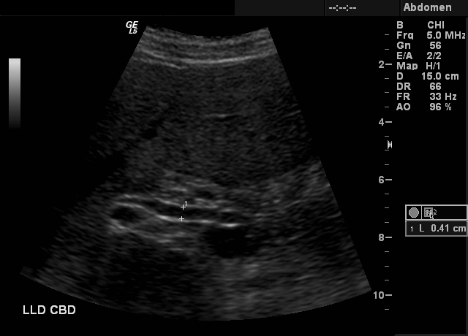

Slide 45
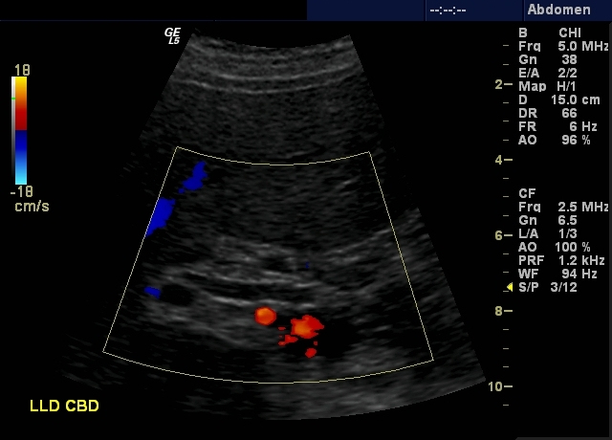

Slide 46
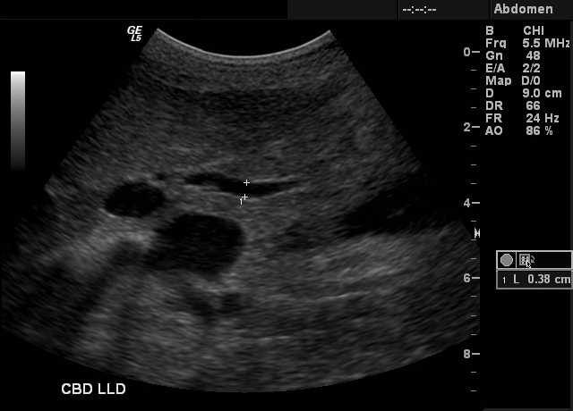

Slide 47
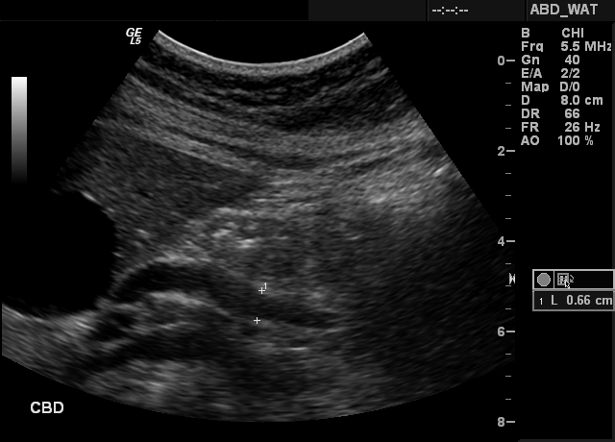

Slide 48
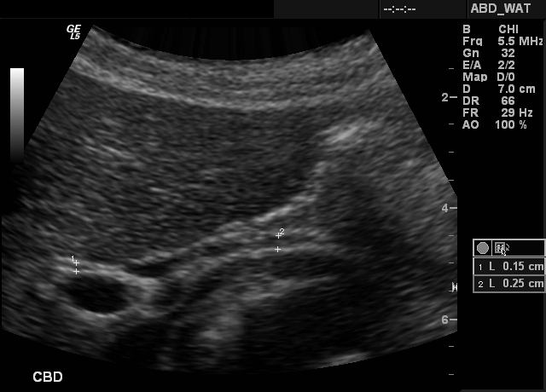

Slide 49
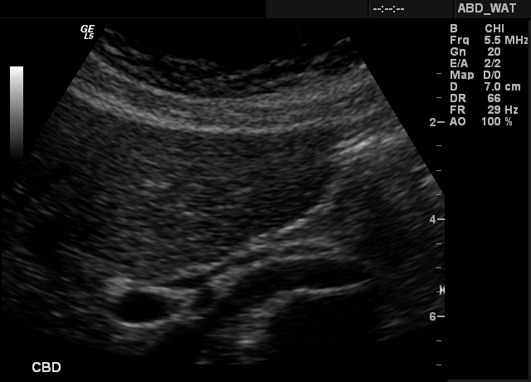

Slide 50
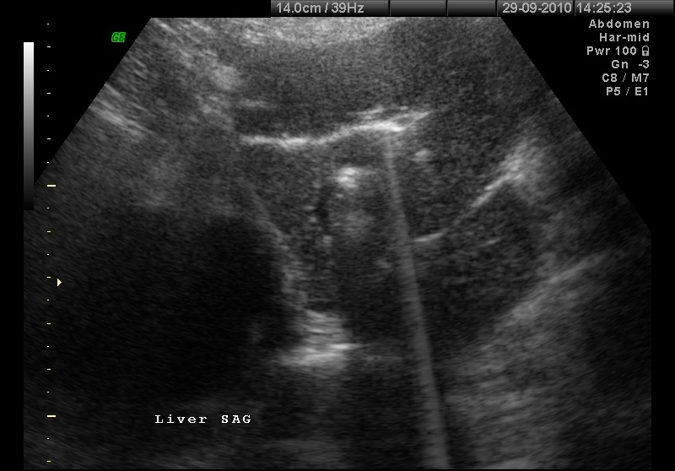

Slide 51
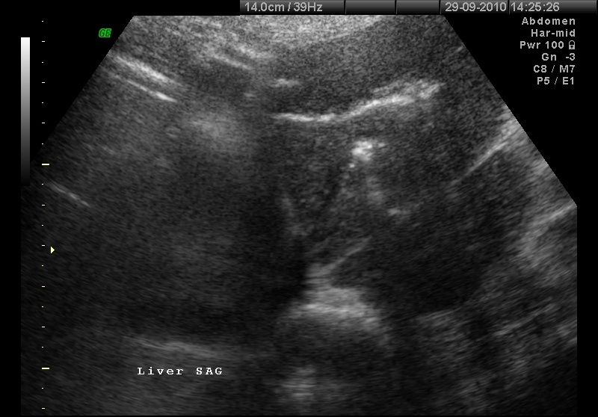

Slide 52
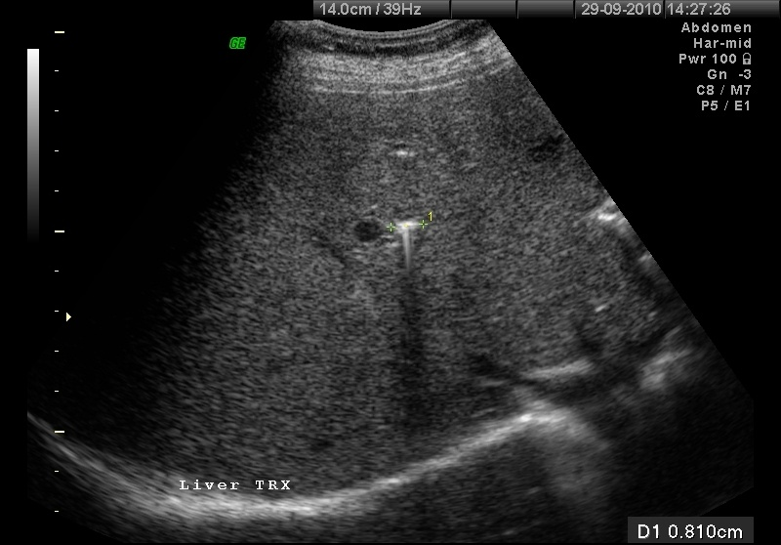

Slide 53
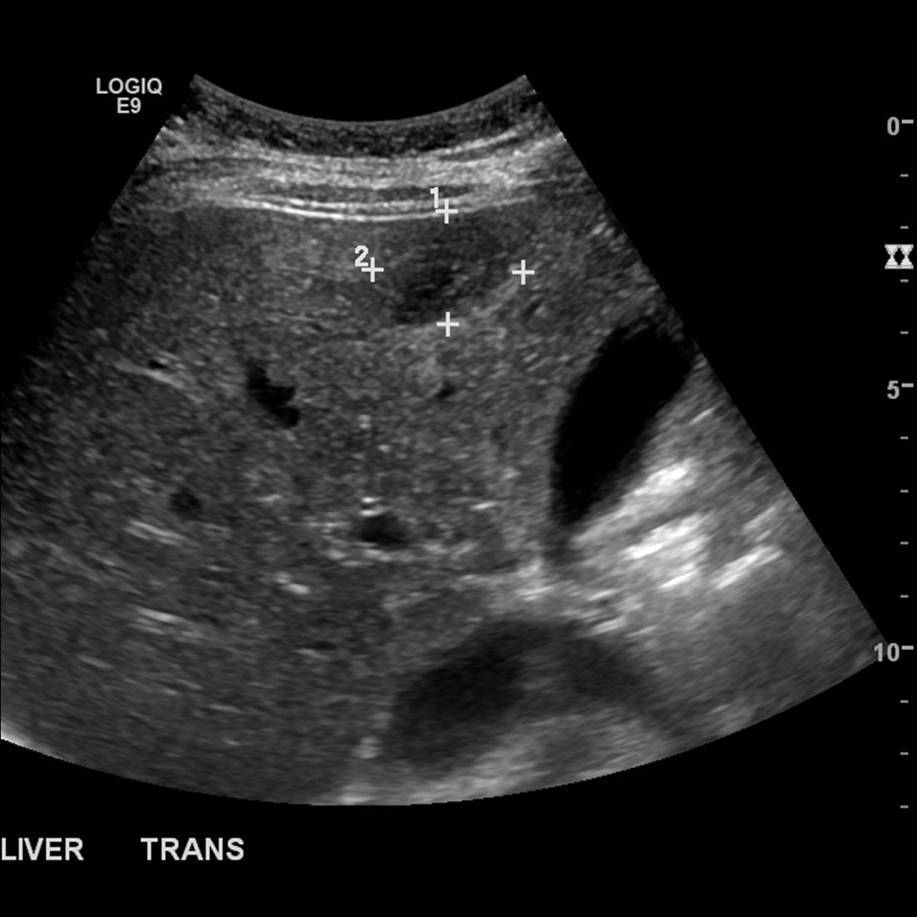
Segment?
Low; gallbladder seen
Right of the gallbladder
Left of the RHV
Segment V

Slide 54
Pancreas
Transverse views: head, uncinate process, body and tail.
Sagittal views: head with IVC and body with aorta.
Measure pancreatic duct
Head: 3.5 mm
Body: 2.5 mm
Tail: 1.5 mm

Slide 55
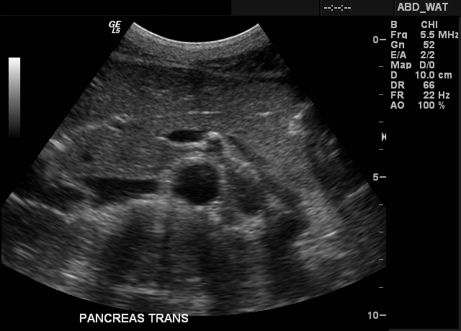

Slide 56
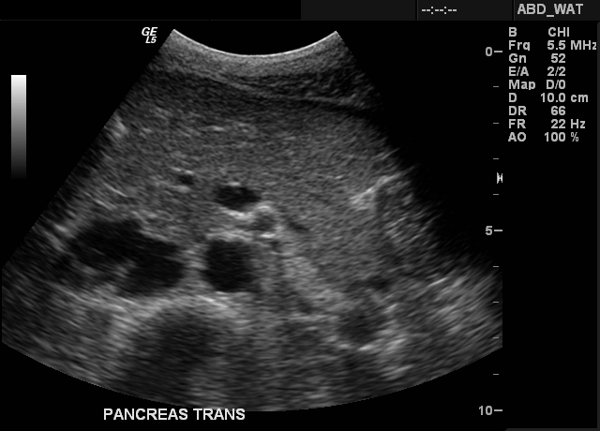

Slide 57
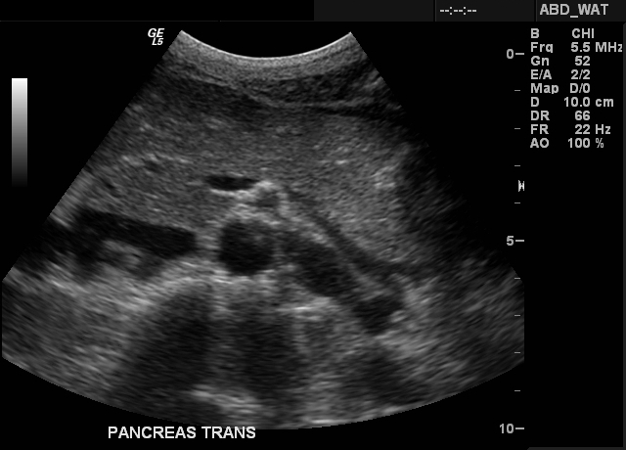

Slide 58
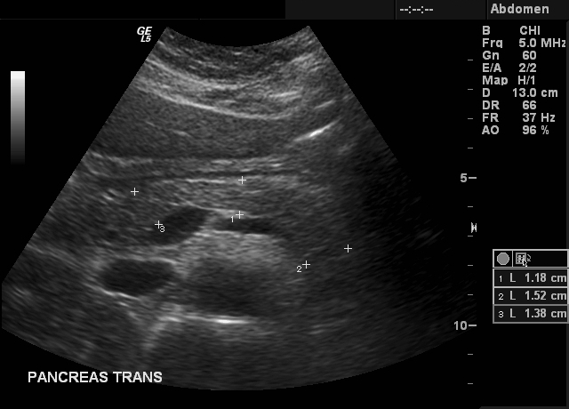

Slide 59
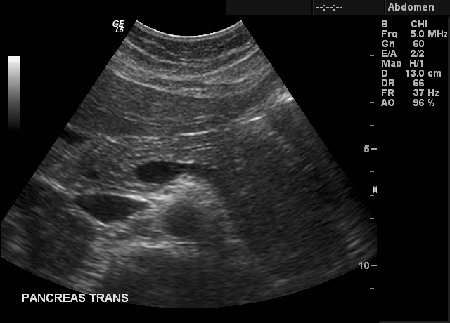

Slide 60
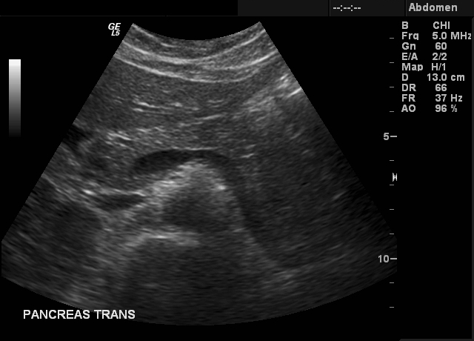

Slide 61
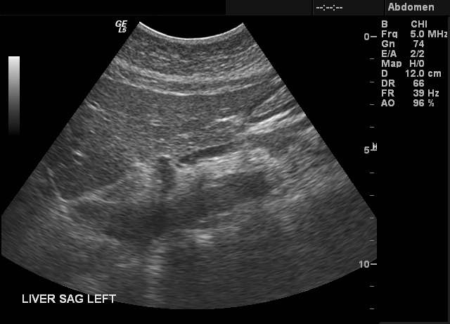

Slide 62
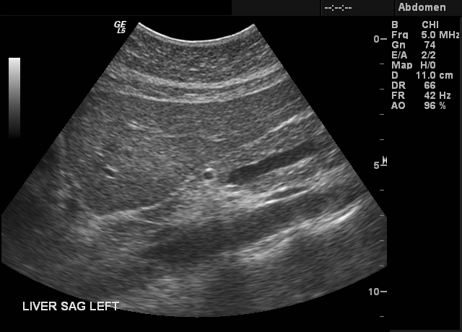

Slide 63
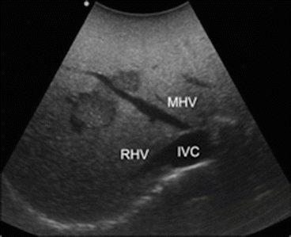
Segment?
High; at the level of the MHV origin
Right of the MHV
Left of RHV
Segment VIII
IVa
High; at the level of the MHV origin
Left of the MHV
Segment IVa
VIII

Slide 64
Aorta & IVC
Sagittal views: proximal, mid and distal aorta to bifurcation (image entire length of aorta)
Transverse views: proximal, mid and distal to bifurcation
Sagittal view of IVC and aorta in the left lateral decubitus position
Measure the mid abdominal aorta in transverse view at the greatest dimension. It is more accurate and should be used for width and AP measurements, esp for AAA
For all AAA, must include images of the bifurcation and both common iliac arteries including AP measurements in transverse plane.

Slide 65
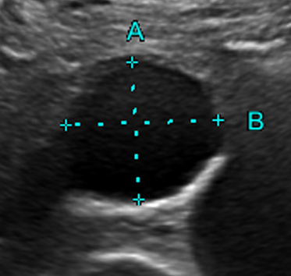
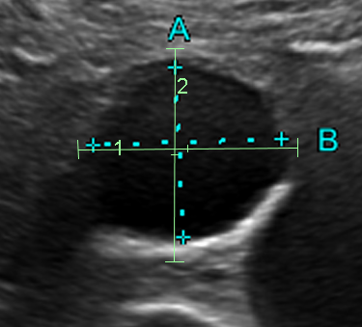
Aorta
Aorta must appear ROUND to ensure right plane for measurement
Measurement must INCLUDE THE WALL. Measuring only the lumen will underestimate aneurysm

Slide 66
Aorta
Measurements:
Normal: < 2.0 cm
Ectasia: > 2.0 cm
Aneurysm: > 3.0 cm

Slide 67
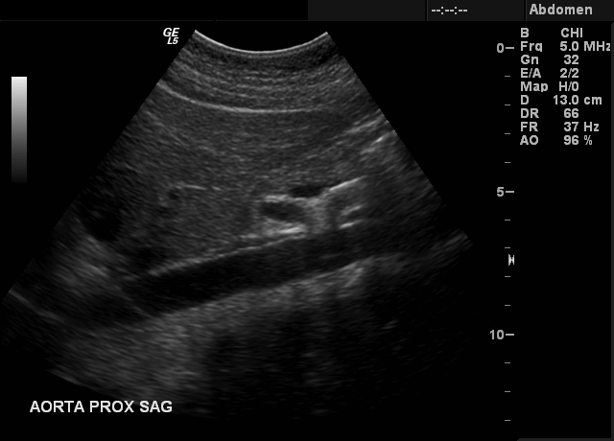

Slide 68
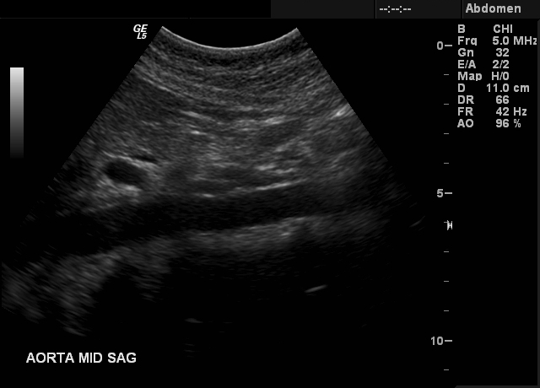

Slide 69
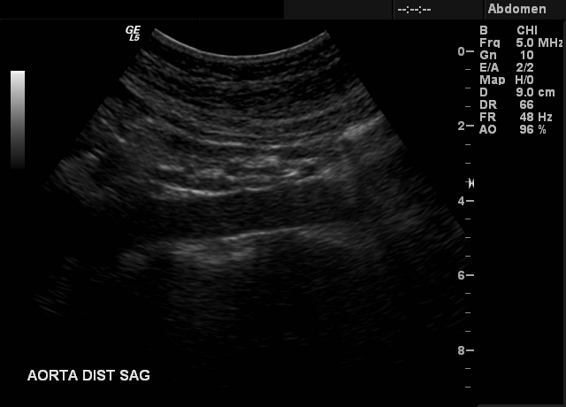

Slide 70
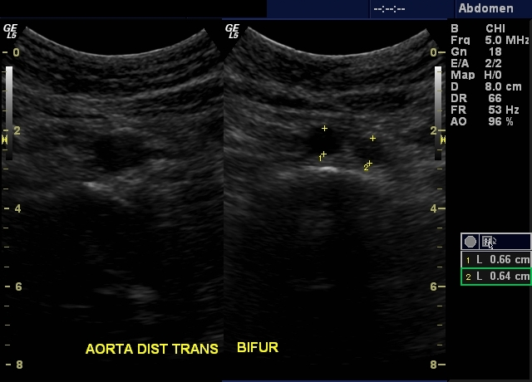

Slide 71
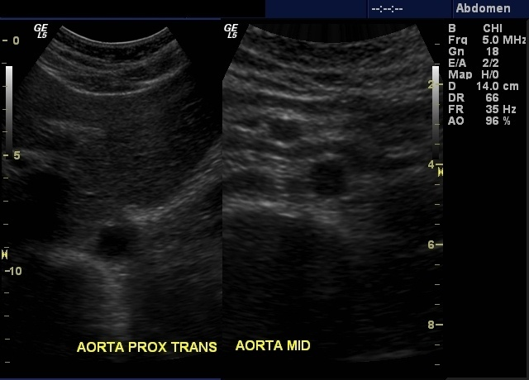

Slide 72
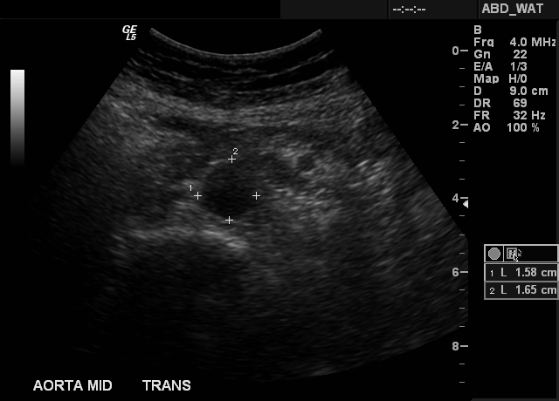

Slide 81
Segment?
Inferior tip of left lobe
Segment III / IVb

Slide 82
Kidneys
Long axis views and measure each kidney
Transverse views: Upper, mid (hila) and lower poles
Pelvicaliectasis: Measure AP dimension of renal pelvis in transverse view
If there is dilatation of the collecting system
**Check for ureteric jets
**Recheck dilatation post-void

Slide 91
Segment?
Left of MHV
At the level of the left portal vein
Segment IVa / IVb

Slide 92
Spleen
Long axis views and measure spleen
Transverse views

Slide 93
Appendix
How to identify?
Find cecum
Identify terminal ileum
Appendix is always inferior to the terminal ileum
Follow entire length from cecum to the blind-ending tip

Slide 94
Segment?
At level of portal vein
Possibly at the RHV
V / VI / VII / VIII

Slide 95
Key Points
Completely fill in worksheets. Do not leave History and Comparison blank
Must compare with previous imaging. Outside studies can be retrieved.
Liver 8 segments
Need to document if gallstones/sludge is mobile
Use more aggressive maneuvers
Sonographic Murphy’s sign needs to be assessed properly
Abdominal aorta wall needs to be included in measurement

